Slide 1
Introduction to R for Data Mining
STRATA 2012
Joseph B. Rickert,
Revolution Analytics
February 28, 2012

Slide 2

Agenda
The R Language
  Where did R come from?
  What makes R different from other statistical software?
Working with Data
  Data structures in R
  Reading and writing data sets
  Manipulating Data
Basic statistics in R
  Exploratory Data Analysis
  Multiple Regression
  Logistic Regression
Data Mining in R
  Cluster analysis
  Classification algorithms
Working with Big Data
  Challenges
  Extensions to R for big data
Where to go from here?
  The R community
  Resources for learning R
  Getting help

Slide 3
The R Language
R History and Organization

Slide 4
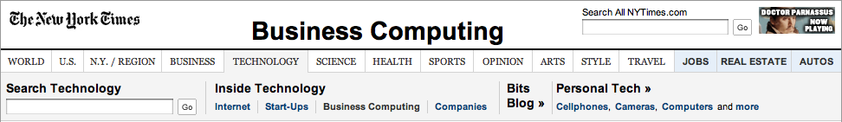
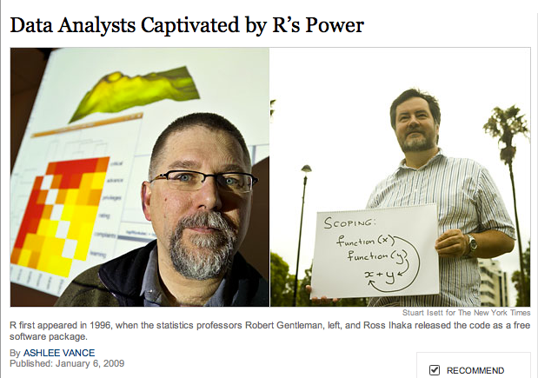
the premier language for statistics and statistical computing
R is an open source (GNU) version of the S language developed by John Chambers et al. at Bell Labs in 80’s History of R, Genesis
R was initially written in early 1990’s by Robert Gentleman and Ross Ihaka then with the Statistics Department of the University of Auckland
Notes:
In his book Software for Data Analysis, Programming with R (Springer 2008) John Chambers acknowledges the contributions of Rick Becker, Allan Wilks. Trevor Hastie, Daryl Pregibon, Diane Lambert, W.S. Cleveland and others from the Bell Labs era of S development.

Slide 5
An Open Source Project
Since 1997 a core group of ~ 20 developers guides the evolution of the language
R is administered and controlled by the R Foundation
The r-project is the place to start
The R ecosystem is extensive

Slide 6
How R is organized
R functions are organized into libraries called packages
The download of R contains the base and recommended packages
User contributed packages are accessible through CRAN, debian, SourceForge, github and elsewhere

Slide 7
Exponential Growth
Scholarly Activity
  Google Scholar hits (’05-’09 CAGR)
“I’ve been astonished by the rate at which R has been adopted. Four years ago, everyone in my economics department [at the University of Chicago] was using Stata; now, as far as I can tell, R is the standard tool, and students learn it first.”
R
46%
SAS
-11%
SPSS
-27%
S-Plus
0%
Stata
10%
Deputy Editor for New Products at Forbes
Package Growth
  Number of R packages listed on CRAN
“A key benefit of R is that it provides near-instant availability of new and experimental methods created by its user base — without waiting for the development/release cycle of commercial software. SAS recognizes the value of R to our customer base…”
Product Marketing Manager SAS Institute, Inc
2002
2004
2006
2008
2010

Slide 8
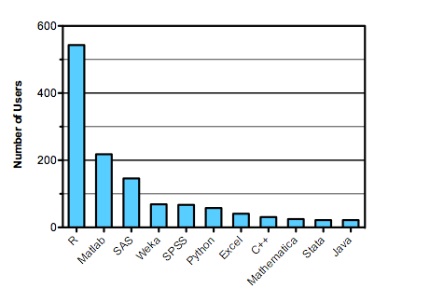
R is the Preferred Tool for Predictive Modelers
Read More
Predictive Analytics
No Free Lunch

Slide 9

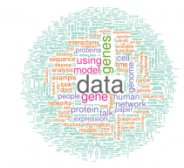
What can you do?
Data Handling
Statistics
Algorithms
Visualization
Reproducible research
And more

Slide 10
Where we can go today
Levels of R Skill
Write production grade code
Write an R package
Write code and algorithms
Use R functions
Use a GUI
R developer
R contributor
Expert R user
R user
R aware
10
10,000
Hours of use
The Malcolm Gladwell “Outlier” Scale

Slide 11
Introductory R Scripts
1.b - Rattle.R
1.c – Data Structures.R
1.d – Some functions.R
1.e – Sample plots.r
1.f – ggplot2.R

Slide 12
Working with data
Data Structures, Reading and Writing Files

Slide 13
Working with Data R Scripts
2.a – Read from csv and web.R
2.b – Read from google.R
2.c – RSQLite.R
2.d – RODBC – MySQL.R
2.e – Manipulating Data.R

Slide 14
Basic Statistics
Exploratory Data Analysis, Linear Models

Slide 15
Basic Statistics R Scripts
3.a – The Basics.R
3.b – Regression.R
3.c – Exploratory Data Analysis.T
3.d – Assessing Predictive Accuracy.R
3.e – Logistic Regression.R

Slide 16
Data mining with r
Clustering and Classifications
Notes:
What needs to be in this section
Overview of data mining: a high level discussion, kinds of problems, some examples
Brief discussion of what we mean by data
Some explanation of theory: models, validation, model assessment, prediction
Some discussion of the grunt work: data acquisition and cleaning
Some simple examples of algorithms, kmeans, trees, svm etc
First run through some simple r code
Show rattle
Talk about ensemble techniques
Extended example with a moderate size data set
Show lift curve or confusion table
PMML example of implementing algorithm in a production setting

Slide 17


Data Mining
Applications
Credit Scoring
Fraud Detection
Actions
Classify
Predict
Ad Optimization
Recommendation systems
Targeted Marketing
Gene Detection
Algorithms
CART
Social Networks
Visualize
Random Forests
SVM
KMeans
Hierarchical clustering
Ensemble Techniques
Acquire Data
Prepare
Optimize
Interpret

Slide 18
Data Mining R Scripts
4.a - Cleaning Data.R
4.b – Explore.R
4.c – Boxplot different skills.R
4.d – Hierarchical corr plot.R
4.e – Basic kmeans.R
4.f – Kmeans.R
4.g – Tree with rpart.R
4.g.2 – Spam tree.R
4.h – Build tree and evaluate.R
4.i – RISK.R
4.j – Conditional Inference Tree.R

Slide 19
Data Mining R Scripts (continued)
4.k – Random Forest.R
4.l – Boosted Tree.R
4.m – SVM.R
4.n – Sentiment analysis.R
4.o – Market Basket Analysis.R
4.p – Multiple Methods.R
4.q – gbm vs tree.R
4.r – Html Report.R
4.r.2 – Report function.R

Slide 20
Big data
Revolution Analytics RevoScaleR and Hadoop
Notes:
What needs to be in this section
Some discussion of the memory limitations of R
Discussion of challenges of big data and big models
Introduce RevoScaleR
Position RevoScaleR above small data below huge data
Show data step
Show logistic regression on large data step
Introduce Hadoop
Present some of data mining camp theory on map reduce
Show syntax of Revo’s rmr package

Slide 21
The Big Data Hierarchy
RHadoop
Infrastructure
Complexity
RevoScaleR
R
Data Size

Slide 22
Big Data R Scripts
5.a – Import Airline csv files.R
5.b – Predict Late Flights.R
5.c – 80 pct.R
5.d – Down Sample.R
5.e – Data Step.R

Slide 23
Hadoop from R
An open Source Projecthttps://github.com/RevolutionAnalytics/RHadoop/wiki

Slide 24
RHdoop
RHadoop is a collection of three R packages that allow users to manage and analyze data with Hadoop.
The packages have been implemented and tested in Cloudera's distribution of Hadoop (CDH3). and R 2.13.0
Full documentation is on github https://github.com/RevolutionAnalytics/RHadoop/wiki

Slide 25
RHadoop contains the following packages
rmr – prodvides Hadoop MapReduce functionality in R
rhdfs – provides file management of the HDFS from within R
rhbase – provides database management for the HBase distributed database from within R

Slide 26
R and Hadoop – The R Packages
HDFS
HBASE
Capabilities delivered as individual R packages
rhdfs - R and HDFS
rhbase - R and HBASE
rmr - R and MapReduce
R
Thrift
Map or Reduce
Task Node
rhdfs
rhbase
R Client
Downloads available from Github
Job Tracker
rmr

Slide 27
Mapreduce similar to R
Conceptually, mapreduce is not very different than a combination of lapplys and a tapply:
Transform elements of a list
Compute an index / key (mapreduce jargon)
Process the groups thus defined.

Slide 28
First Mapreduce Job (Map step)
R code doing similar process
    small.ints = 1:10
    out = lapply(small.ints, function(x) x^2)
R code for Mapreduce job
    small.ints = to.dfs(1:10)
    out = mapreduce(input = small.ints, map = function(k,v) keyval(v, v^2)

Slide 29
Output from Map step
The return value is an object (actually a closure)
  can pass it as input to other jobs
  read it into memory with from.dfs
from.dfs is the dual of to.dfs
  returns a list of key value pairs,
  useful in defining practical map reduce algorithms whenever a mapreduce job produces something of reasonable size

Slide 30
Where to go from here?
More than code, R is a community

Slide 31
Look at some more sophisticated examples
Thomson Nguyen on the Heritage Health Prize
Shannon Terry & Ben Ogorek (Nationwide Insurance): A Direct Marketing In-Flight Forecasting System
Jeffrey Breen: Mining Twitter for Airline Consumer Sentiment
Joe Rothermich: Alternative Data Sources for Measuring Market Sentiment and Events (Using R)

Slide 32
Continue to learn R
RevoJoe: How to Learn R
R Documentation
  Task Views
  Machine Learning & Statistical Learning
  R Package Documentation
  The R Journal
  Books
  Reference Card and more
Some helpful places on the Web
  The Revolutions Blog
  Inside-R.org
  Rob Kabacoff: Quick-R
  Some Web Resources
  RDataMining.com
  ReadWrite Hack

Slide 33
Enter a Competition
kaggle

Slide 34

Get involved with the R Community
Bay Area R User Group
Find user groups around the world
Attend UserR

